Slide 1

Machine Learning for Breast Cancer Diagnosis: A Data-Driven Approach
Enhancing diagnosis with data-driven methods
Jonghun Park
Xiao Zhong
Tang Yip

Slide 2
Agenda
Breast Cancer
Statistics in Australia
Screening and Early Diagnosis
Diagnosis-optimized Strategy
Breast Cancer Dataset Overview
Data Overview
Exploration and Cleaning
Data Balancing
Feature Engineering
Distribution after Scaling
Boxplot
Pairplot
Heatmap
Feature Selection
Principal Component Analysis (PCA)
Forward Stepwise
Machine Learning Algorithms
LR, SVM, RF, and KNN
Cross Validation
Evaluation
Ensemble method
Final Training
Model Training and Validation
Model Training, Hyperparameter Tunning, Testing
Deployment and Monitoring
Community Resource Optimization

Slide 3

Breast Cancer Statistics in Australia
Breast cancer is the most common cancer among women in Australia and the second leading cause of cancer-related deaths after lung cancer. In 2024, an estimated 20,973 people were diagnosed, with the average age at diagnosis being 62.
By age 85, 1 in 8 females and 1 in 667 males in Australia are expected to be diagnosed with breast cancer. Participation in national cancer screening programs reduces mortality risk by 54%-63%.
Breast Screen Australia (BSA) screened over 1.8 million women aged 50-74 screened in 2018–2019. Since the program’s inception, mortality rates have significantly declined from 74 deaths per 100,000 women in 1991 to 40 per 100,000 in 2018.
Early detection through effective screening is crucial for improving survival outcomes in breast cancer cases.

Slide 4
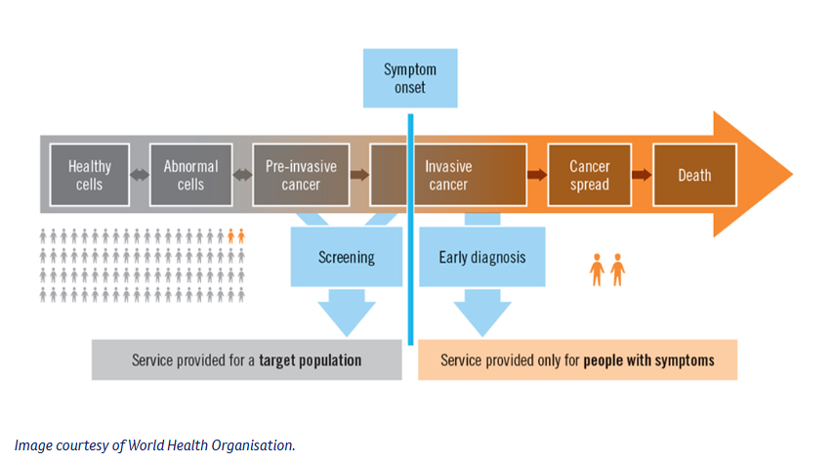
Screening and Early Diagnosis
Breast cancer screening
Increase participation rate of breast cancer screening rate to at least 65% by 2025.
After a diagnosisMachine learning models lead to improve accuracy in diagnoses, ensuring patients receive the correct treatment or follow up
Early detection
Screening survival rates.
Notes:
Breast cancer is the most diagnosed cancer among women in Australia. With early diagnosis, survival rates significantly increase. This highlights the need for tools that support timely and accurate diagnosis—something ML can help with.

Slide 5
Diagnosis-optimized Strategy
Early Detection Through Enhanced Screening
Post-Diagnosis Decision Support
Optimized Resource Allocation Across Communities
By accurately stratifying risk and prioritizing high-probability cases, healthcare systems can better allocate limited resources—including diagnostic tools, specialists, and follow-up services—particularly in underserved or remote areas. This improves equity in care access and overall screening efficiency.
Leveraging machine learning models with high recall and F1-scores enables more accurate and earlier detection of breast cancer cases. Integrating these models into screening workflows improves diagnostic precision and reduces missed cases, encouraging trust and participation in regular screenings.
Our predictive models assist healthcare providers in identifying true positive cases with greater confidence. This supports timely and appropriate treatment or follow-up plans, reducing delays and minimizing over-treatment or unnecessary interventions.
Notes:
To contribute to the National Preventive Health Strategy’s goal of increasing breast cancer screening rates to at least 65% by 2025, our machine learning initiative focuses on a diagnosis-optimized strategy with three key pillars:

Slide 6
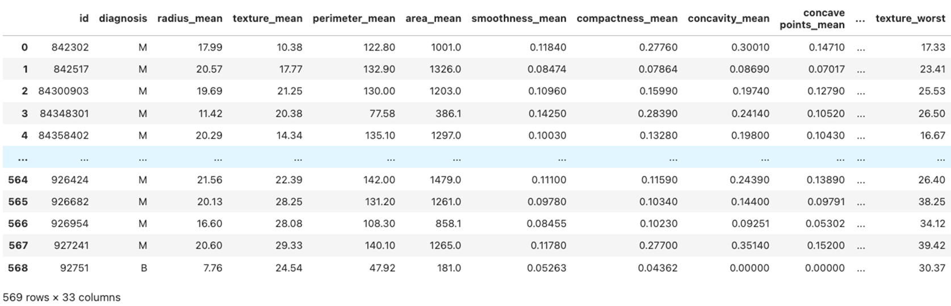
Dataset Overview
Data
Breast Cancer Wisconsin (Diagnostic) Data Set
Source
Kaggle
Features
are computed from a digitized image of describing characteristics of the cell nuclei
Data size
569 rows × 33 columns before cleaning
Notes:
Why We Scale the Data
“We apply Standard Scaling to ensure that all features contribute equally to machine learning models. It adjusts each feature to have a mean of 0 and a standard deviation of 1.”
Some features (like “area” or “radius”) have larger numerical ranges.
Algorithms like KNN, SVM, logistic regression, and PCA are sensitive to feature scale.
Interpreting the Distribution Plots
“After scaling, we plotted the distribution of each feature. This helps us understand the shape of the data, spot outliers, and detect skewness or multi-modal behavior.”
What to highlight from the plot:
Most features are roughly bell-shaped (normal distribution), especially after scaling.
Some features may still show skewness (e.g., positive or negative tails).
There are a few features that appear bimodal—which may reflect differences between malignant and benign classes.
"Even after scaling, some features still show interesting distribution patterns. This might suggest that they are highly discriminative between cancerous and non-cancerous cases."
“Understanding the distribution of features gives us intuition about which variables might be more informative. For instance, features with more variation or bimodality can be great predictors.”
Skewed features might still show long tails → these may need further transformation (like log scaling).
Bimodal features might be very informative for classification — they're showing clear differences between the two tumor types!

Slide 7
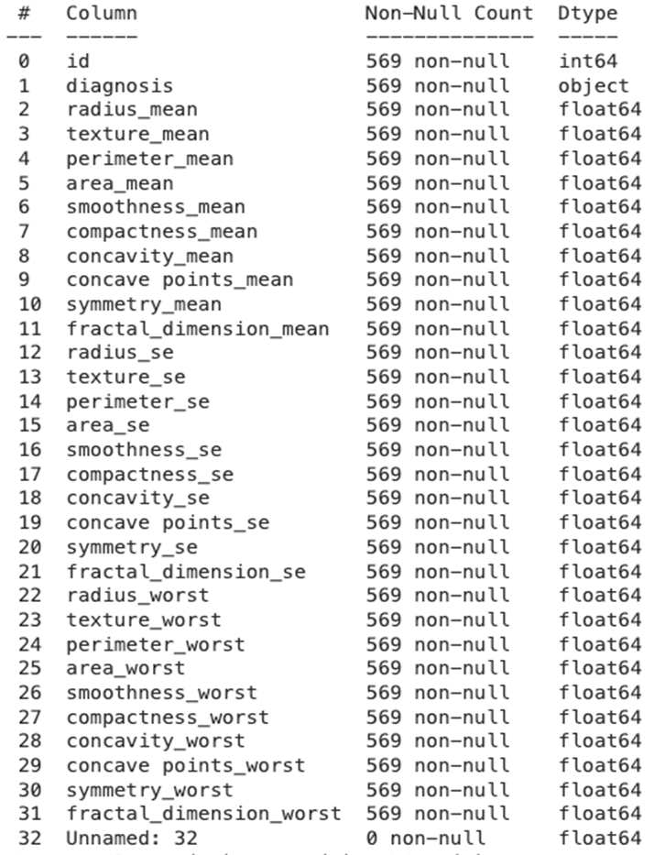
Data Exploration and Cleaning
To be removed
Id cannot be used for classification
Unnamed includes NaN
After cleaning
No more Missing found
Diagnosis is to be used as class labels:
‘M’ = Malignant, Cancerous (potentially dangerous)
‘B’ = Benign, Non-cancerous
10 real-valued features and 3 values are computed for each nucleus
Resulting in 30 features.
Notes:
Why We Scale the Data
“We apply Standard Scaling to ensure that all features contribute equally to machine learning models. It adjusts each feature to have a mean of 0 and a standard deviation of 1.”
Some features (like “area” or “radius”) have larger numerical ranges.
Algorithms like KNN, SVM, logistic regression, and PCA are sensitive to feature scale.
Interpreting the Distribution Plots
“After scaling, we plotted the distribution of each feature. This helps us understand the shape of the data, spot outliers, and detect skewness or multi-modal behavior.”
What to highlight from the plot:
Most features are roughly bell-shaped (normal distribution), especially after scaling.
Some features may still show skewness (e.g., positive or negative tails).
There are a few features that appear bimodal—which may reflect differences between malignant and benign classes.
"Even after scaling, some features still show interesting distribution patterns. This might suggest that they are highly discriminative between cancerous and non-cancerous cases."
“Understanding the distribution of features gives us intuition about which variables might be more informative. For instance, features with more variation or bimodality can be great predictors.”
Skewed features might still show long tails → these may need further transformation (like log scaling).
Bimodal features might be very informative for classification — they're showing clear differences between the two tumor types!

Slide 8
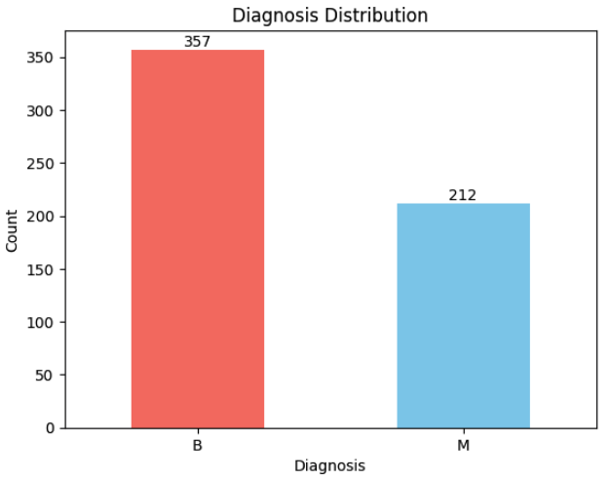
Data Balancing
The imbalance is about 62% benign (B) and 38% malignant (M), which isn't extreme.
The methods proposed:
Resampling (oversampling the minority class, under-sampling the majority class or SMOTE)
Ensemble Methods
Adjusting class weights in algorithms
Notes:
Synthetic Minority Over-sampling Technique (SMOTE)

Slide 9
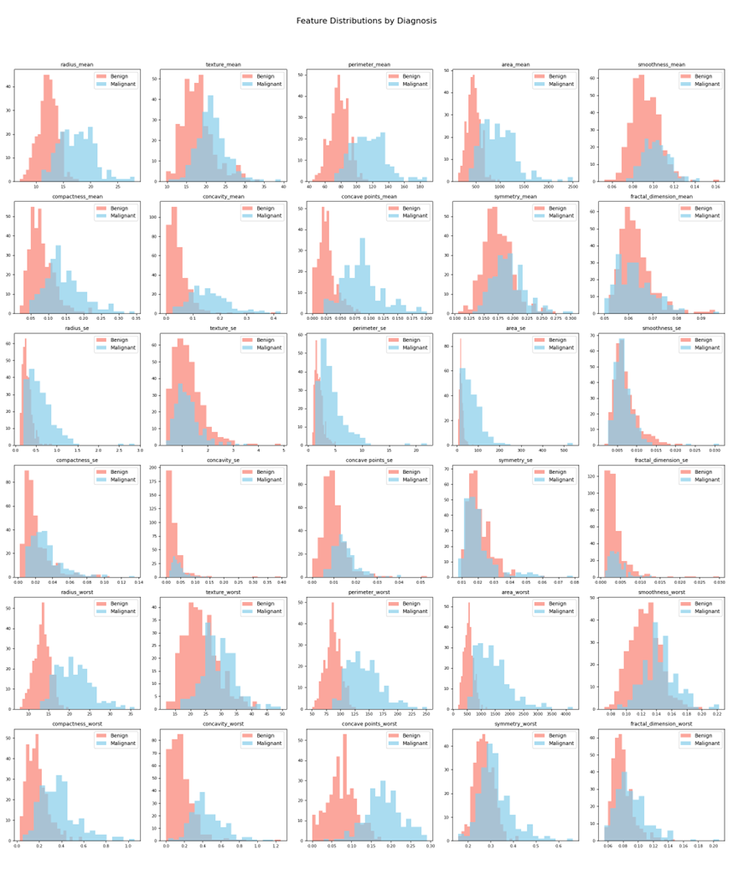
Features Distribution
Range of values
Outlier detection
Notes:
We explored the feature distributions using boxplots, pairplots, and heatmaps to detect outliers and correlations.
This helped us spot redundant features and identify which ones carried the most predictive power.

Slide 10
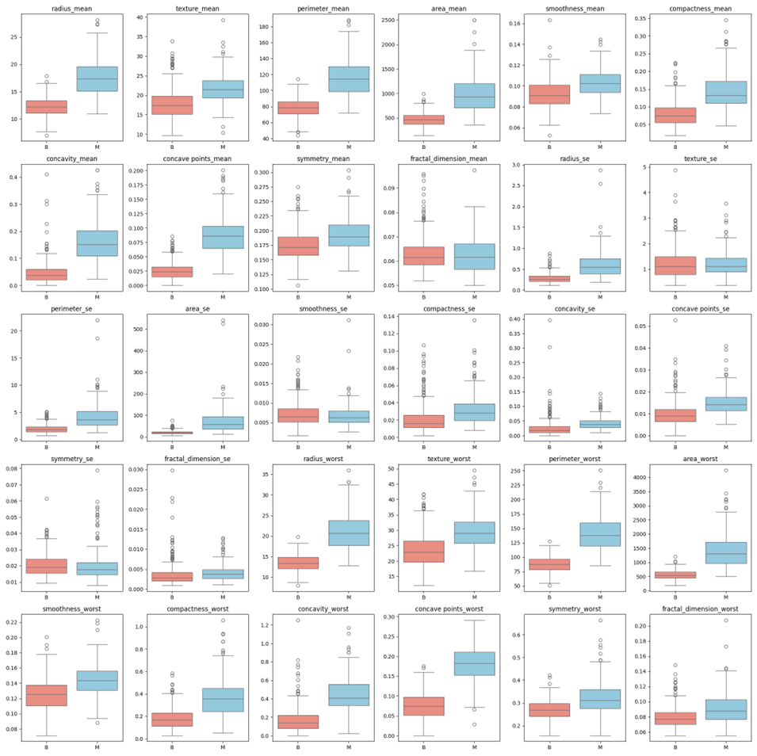
Features Distribution
Range of values
Outlier detection
Notes:
Why We Scale the Data
“We apply Standard Scaling to ensure that all features contribute equally to machine learning models. It adjusts each feature to have a mean of 0 and a standard deviation of 1.”
Some features (like “area” or “radius”) have larger numerical ranges.
Algorithms like KNN, SVM, logistic regression, and PCA are sensitive to feature scale.
Interpreting the Distribution Plots
“After scaling, we plotted the distribution of each feature. This helps us understand the shape of the data, spot outliers, and detect skewness or multi-modal behavior.”
What to highlight from the plot:
Most features are roughly bell-shaped (normal distribution), especially after scaling.
Some features may still show skewness (e.g., positive or negative tails).
There are a few features that appear bimodal—which may reflect differences between malignant and benign classes.
"Even after scaling, some features still show interesting distribution patterns. This might suggest that they are highly discriminative between cancerous and non-cancerous cases."
“Understanding the distribution of features gives us intuition about which variables might be more informative. For instance, features with more variation or bimodality can be great predictors.”
Skewed features might still show long tails → these may need further transformation (like log scaling).
Bimodal features might be very informative for classification — they're showing clear differences between the two tumor types!

Slide 11
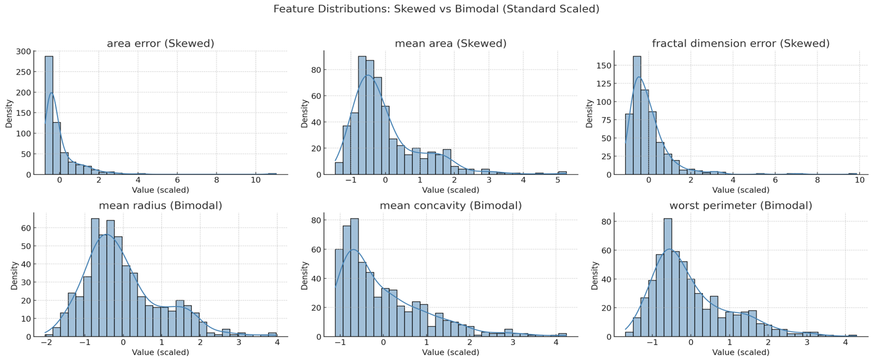
Features Engineering
Notes:
Why We Scale the Data
“We apply Standard Scaling to ensure that all features contribute equally to machine learning models. It adjusts each feature to have a mean of 0 and a standard deviation of 1.”
Some features (like “area” or “radius”) have larger numerical ranges.
Algorithms like KNN, SVM, logistic regression, and PCA are sensitive to feature scale.
Interpreting the Distribution Plots
“After scaling, we plotted the distribution of each feature. This helps us understand the shape of the data, spot outliers, and detect skewness or multi-modal behavior.”
What to highlight from the plot:
Most features are roughly bell-shaped (normal distribution), especially after scaling.
Some features may still show skewness (e.g., positive or negative tails).
There are a few features that appear bimodal—which may reflect differences between malignant and benign classes.
"Even after scaling, some features still show interesting distribution patterns. This might suggest that they are highly discriminative between cancerous and non-cancerous cases."
“Understanding the distribution of features gives us intuition about which variables might be more informative. For instance, features with more variation or bimodality can be great predictors.”
Skewed features might still show long tails → these may need further transformation (like log scaling).
Bimodal features might be very informative for classification — they're showing clear differences between the two tumor types!

Slide 12
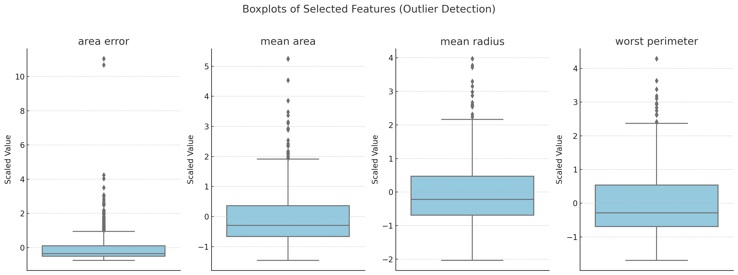
Boxplot
Notes:
A boxplot (a.k.a. box-and-whisker plot) summarizes the distribution of a dataset and highlights potential outliers.
"The dots beyond the whiskers are statistical outliers. In medical data, these could represent tumors with significantly larger size or unusual properties. While they might be true values, it’s essential to consider them carefully—they could skew the model or contain important clinical insights."
Keep them: if they’re valid and meaningful (e.g., aggressive tumors).
Transform: to reduce their impact (e.g., use log-scaling).
Remove: only if they are likely errors or extremely rare cases.

Slide 13
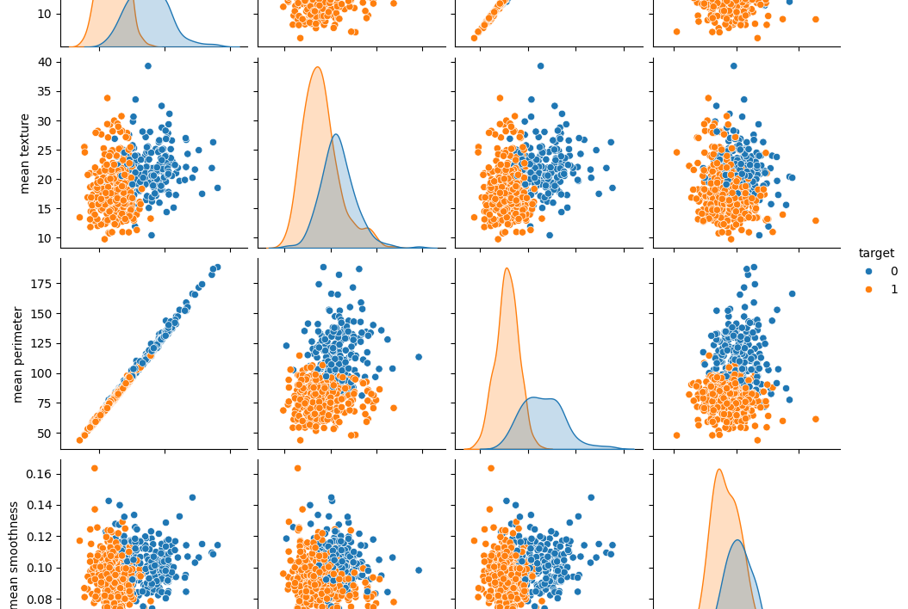
Pairplot
Notes:
The pairplot shows pairwise scatter plots for different features, with the points color-coded by whether the tumor is benign or malignant.
"Before applying any machine learning models, it's important to understand the relationships between features. One powerful way to do that is using a pairplot. It helps us see patterns, correlations, and potential for separating classes."
"This is a pairplot showing selected features from the breast cancer dataset. Each point represents a sample. The diagonal shows the distribution of individual features, while the off-diagonals show scatterplots between two features, colored by class (benign or malignant)."
Class Separation
"We can observe that some feature pairs show clear separation between classes. For example, mean radius vs. mean texture shows two distinct clusters. This tells us that these features are useful for classification."
Correlated Features
"Some scatterplots show a strong linear trend, like mean area and mean radius. This suggests they’re highly correlated. We might consider removing one to reduce redundancy or applying dimensionality reduction techniques like PCA."
This visual insight helps guide feature selection. We can choose features that best separate the classes and drop or transform features that are highly correlated or skewed. This can improve model performance and reduce overfitting."
"I’ve selected these four features from the dataset: mean radius, mean texture, mean perimeter, and mean smoothness. These were chosen to highlight class separation and correlation patterns. For instance, we can see that mean radius and mean perimeter are strongly correlated, which is common since larger tumors tend to have larger perimeters."
"Notice how malignant and benign cases often cluster separately, especially along the mean radius and mean texture axes. That tells us these features will be valuable for classification."

Slide 14
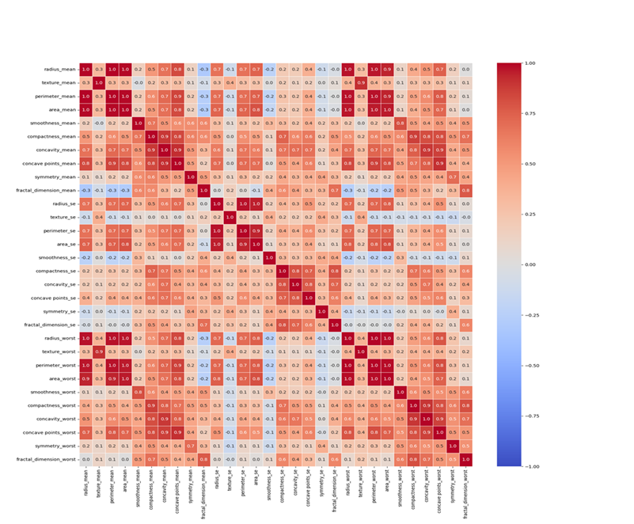
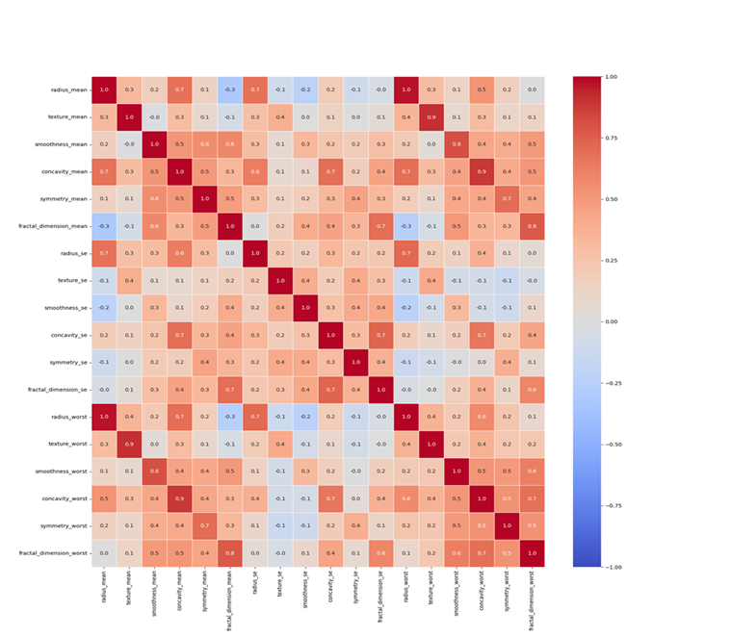
Feature Correlation Heatmap
Notes:
Dropping Highly Correlated Features > (0.9 ???)
Avoid Multicollinearity:
Highly correlated features can lead to multicollinearity, where two or more features provide redundant information.
This makes it difficult for the model to distinguish their individual effects on the target variable, leading to unreliable coefficient estimates in models like linear regression and logistic regression.
Improve Model Performance:
Removing redundant features helps the model generalize better and avoid overfitting, especially in tree-based models and deep learning.
Reduce Overhead & Training Time:
Fewer features mean lower computational cost, faster model training, and less memory usage.
Simplifies the model and speeds up inference.
Enhance Interpretability:
Reducing redundant features makes it easier to analyse feature importance and understand the impact of different variables.
Prevent Data Leakage & Overfitting:
Highly correlated features may lead to data leakage, where a feature indirectly reveals information about the target variable.
Removing them ensures a more robust model.

Slide 15
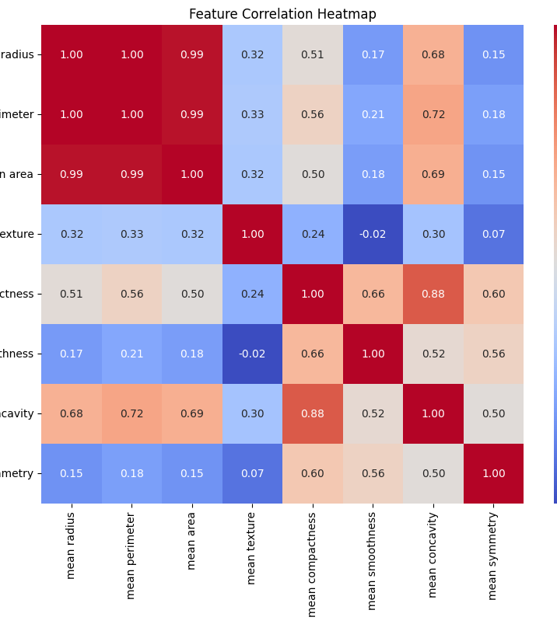
Feature Correlation Heatmap
Identify patterns, correlations, and trends.
Higher and lower values are visually distinguished using different shades or colours.
Notes:
"A heatmap is a visual representation of the correlation matrix. Each cell shows the correlation coefficient between a pair of features, ranging from -1 to 1. A value close to 1 means strong positive correlation, -1 means strong negative correlation, and 0 means no correlation."
"We use a heatmap to quickly identify highly correlated features. If two features are strongly correlated, they might provide redundant information to the model. This can lead to overfitting or unnecessarily complex models."
"In this heatmap, we can see that mean radius, mean perimeter, and mean area are very highly correlated — the values are close to 1. That makes sense — larger tumors tend to have bigger radius, perimeter, and area. So, instead of keeping all three, we might choose one or apply dimensionality reduction like PCA."
"We can also spot some features with low or negative correlation to others, which could add unique information to the model."
"By identifying these relationships visually, we can make smarter choices about which features to keep, combine, or drop."

Slide 16
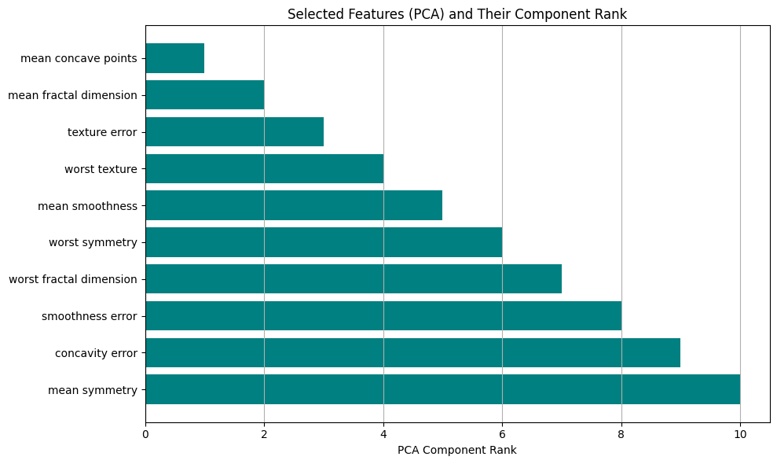
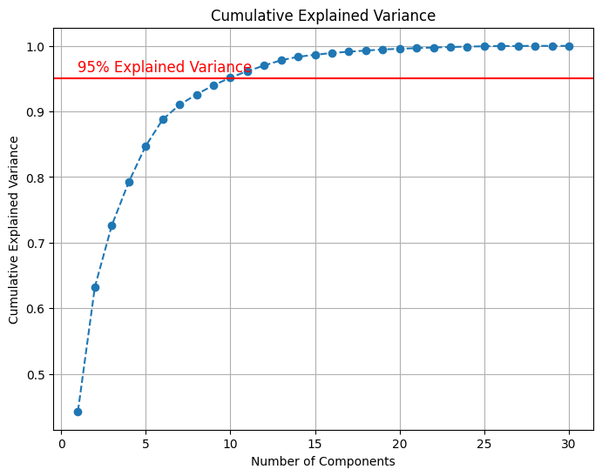
Features Selection Principal Component Analysis (PCA)
Notes:
"Principal Component Analysis, or PCA, is a technique used to reduce the number of features while preserving as much variance (or information) in the data as possible. It transforms the original features into new, uncorrelated components called principal components."
"In datasets like the breast cancer dataset, many features are correlated, which means they provide overlapping information. PCA helps us combine these correlated features into fewer components that still capture most of the data’s structure. This makes models faster, simpler, and often more accurate."
Cumulative Explained Variance: Each principal component explains a portion of the total variance in the data. The cumulative explained variance is the sum of the variance explained by each component up to a certain point.
To achieve 95% cumulative explained variance, you select the minimum number of principal components needed such that their combined explained variance is at least 95%. These selected components represent the most important information in the data.
Features explaining 95% variance: ['mean concave points', 'mean fractal dimension', 'texture error', 'worst texture', 'mean smoothness', 'worst symmetry', 'worst fractal dimension', 'smoothness error', 'concavity error', 'mean symmetry']
Selected Features (emphasizing recall): ['mean concave points', 'mean fractal dimension', 'texture error', 'worst texture', 'mean smoothness', 'worst symmetry', 'worst fractal dimension', 'smoothness error', 'concavity error', 'mean symmetry']
The goal is to reduce features without losing too much valuable information. Aiming for 95% cumulative explained variance ensures that the reduced dataset still represents the original data well.

Slide 17
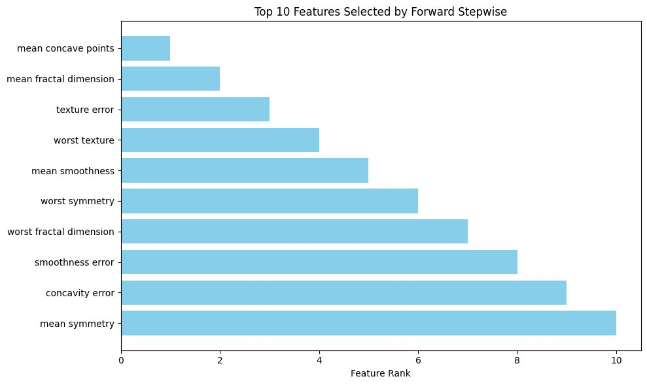
Features Selection Forward Stepwise
Notes:
SFS is a greedy search algorithm that selects a subset of features by iteratively adding or removing features based on their performance in a model.
Here, I used forward selection, which starts with no features and adds one at a time based on their contribution to model performance.
SFS is a simple yet effective technique for selecting the best subset of features, especially when the feature space is large, and you want to avoid overfitting by using only the most important features.
Selected Features: [np.str_('mean concavity'), np.str_('mean fractal dimension'), np.str_('texture error'), np.str_('smoothness error'), np.str_('symmetry error'), np.str_('worst texture'), np.str_('worst area'), np.str_('worst smoothness'), np.str_('worst compactness'), np.str_('worst concavity')]
The goal is to reduce features without losing too much valuable information. Aiming for 95% cumulative explained variance ensures that the reduced dataset still represents the original data well.

Slide 18
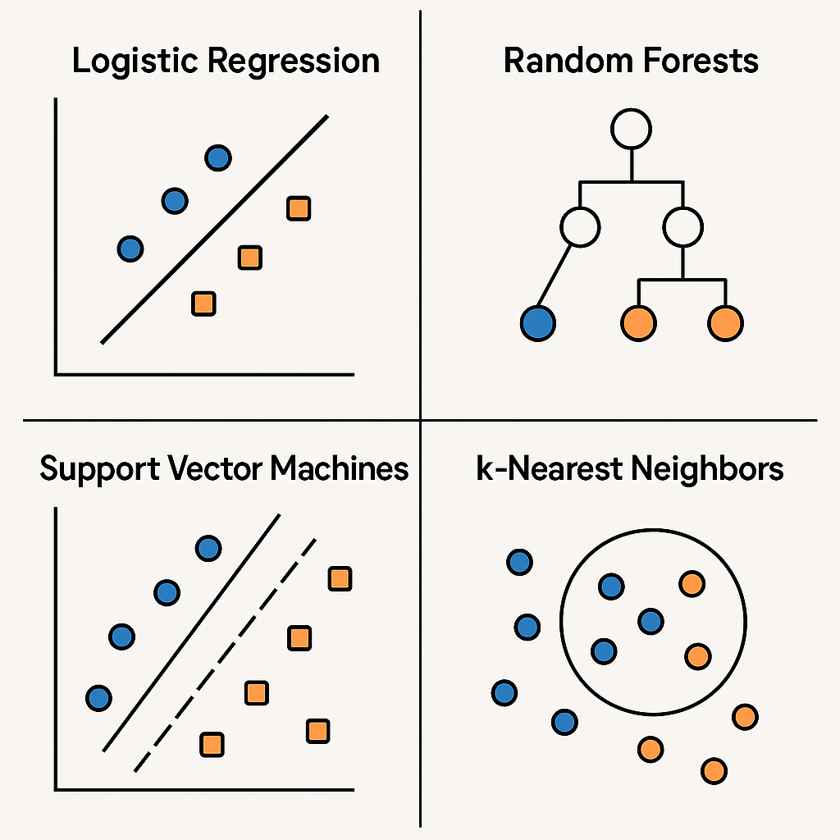
LR, RF, SVM and KNN
Logistic Regression – A classification algorithm that predicts probabilities and assigns data points to binary categories (e.g., yes/no) using a sigmoid function.
Random Forests – An ensemble learning method that builds multiple decision trees and combines their outputs to improve accuracy and reduce overfitting.
Support Vector Machines (SVM) – A classification algorithm that finds the best boundary (hyperplane) to separate different classes with the largest margin.
K-Nearest Neighbors (KNN) – A classification and regression algorithm that assigns a label to a new data point based on the majority class of its nearest neighbors.
Notes:
Logistic Regression (LR)
Simple & Interpretable: Good baseline model for binary classification like benign vs. malignant.
Fast training and works well when the relationship between the features and target is roughly linear.
Provides probabilities, which can help interpret model confidence.
Random Forest (RF)
Powerful & robust: Handles non-linear relationships and feature interactions well.
Reduces overfitting by averaging multiple decision trees.
Good for handling noise and feature importance analysis.
Support Vector Machine (SVM)
Great for high-dimensional spaces like this dataset with 30 features.
Maximizes margin between classes, which often leads to high accuracy.
Effective when the classes are well-separated.
K-Nearest Neighbors (KNN)
Simple and non-parametric: Makes no assumption about the data distribution.
Classification is based purely on similarity (distance), which works well in structured datasets.
Useful as a comparison with more complex models.

Slide 19
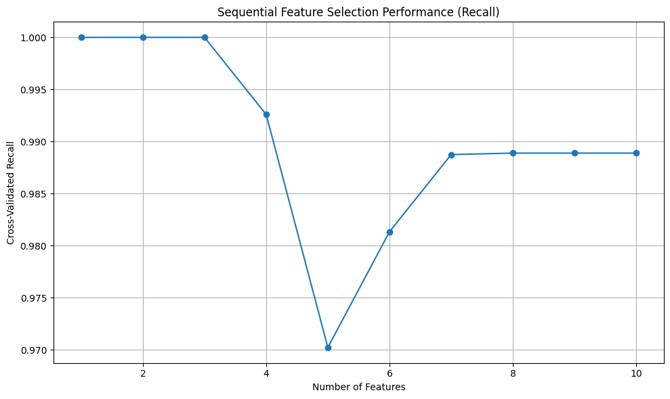
Cross Validation
Notes:
For recall optimization, SFS is likely to perform better since it is tailored for selecting features that maximize recall, whereas PCA + RFE might lose some important details by focusing on components rather than individual features.
As you can see from the output, the highest mean recall score (approximately 0.976) was achieved when using a cross-validation fold of 3.
While cv=3 gives a perfect recall score, you should consider the stability and generalisation ability of the model. A slight drop in recall from cv=3 to cv=5 or cv=10 (which is still very high) suggests that the model is more robust with more folds.
cv=5 and cv=10 should be preferred for most use cases, especially in real-world applications, because they provide more stable results and reduce the likelihood of overfitting.
cv=5 or cv=10 would likely be better choices for final model selection, as they provide more reliable estimates of the model's performance on unseen data. cv=3 could be used as a quick test, but it shouldn't be relied on for selecting the final model.

Slide 20
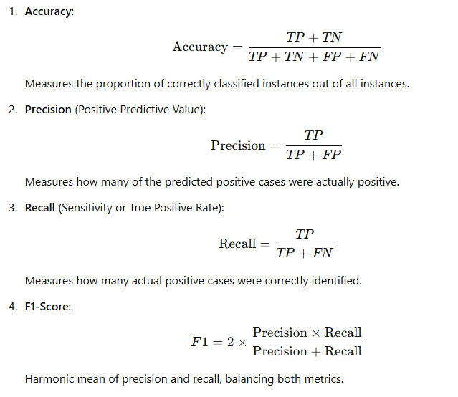
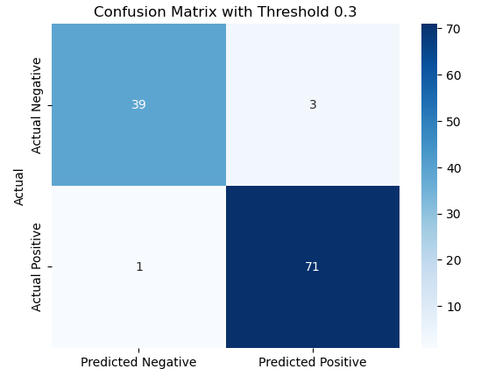
Evaluation
Notes:
Accuracy can be misleading if classes are imbalanced. In this project, since benign cases are more common, a model could be “accurate” just by predicting most samples as benign—but that’s dangerous. Therefore, we take True positive rate into the consideration, High recall = low false negatives. This is critical for cancer detection—we don't want to miss a real case of cancer. A model with slightly lower accuracy but high recall is better for patient safety than one that misses malignant cases.

Slide 21
Ensemble Methods
Boosting
Boosting focuses on improving weak models by combining them sequentially. Each model attempts to correct the errors of the previous one.
It aims to reduce bias and is effective when models are weak learners (e.g., shallow decision trees).
Boosting may overfit if the base learners are too complex.
Bagging
Bagging reduces variance by training models independently using bootstrapped subsets of the data and then averaging their predictions.
It works well with high-variance models (e.g., deep decision trees) and helps prevent overfitting.
Bagging does not focus on the sequential dependency between models.
Notes:
We also explored ensemble techniques:
Boosting, which builds models sequentially to fix errors from the previous ones
Bagging, which builds models in parallel and averages them to reduce variance Both helped improve the stability and performance of our models.

Slide 22
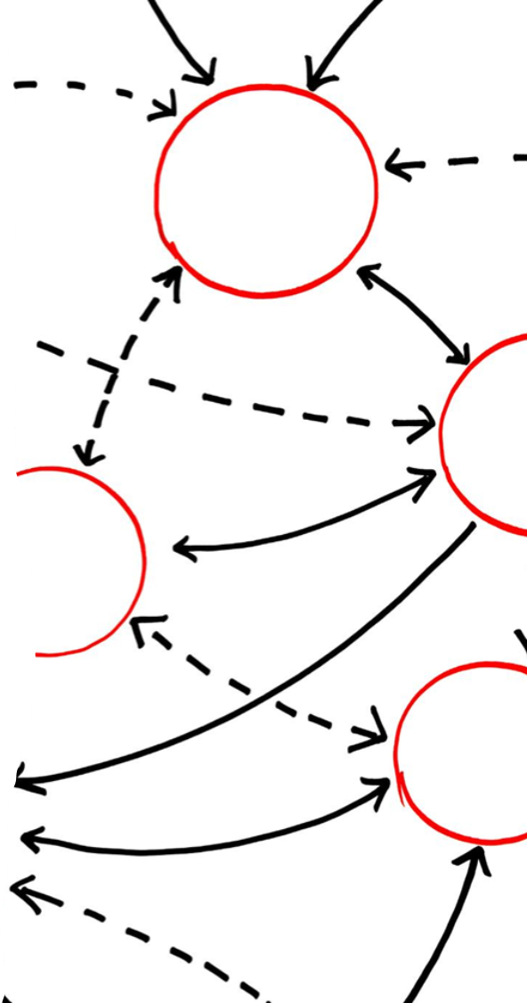
Model Training, Hyperparameter Tunning, Testing
Model Training - using training data to fit the model by adjusting parameters.
Hyperparameter Tunning – Optimizing model settings to improve performance.
Testing (model Evaluation) – assessing the trained model on a separate test dataset
Compare model performances across specific metric in Accuracy, Precision, Recall, and F1-Scor.
Highlight strengths and weaknesses of various models for better decision-making.
Identifying the best model .
Notes:
Based on overall performance metrics, especially recall and Accuracy, to ensure effectiveness in detecting malignant cases. After training, hyperparameter tuning, and testing. Final model parameters were used to evaluate performance on test data, then apply in real-world settings.

Slide 23
Deployment and Monitoring
Develop a user-friendly interface for medical professionals to use the model effectively.
1
Monitor the model's performance in real-world settings and update it as needed.
2
Ensure compliance with ethical standards and data privacy regulations.
3
Notes:
using final model parameters to evaluate performance on test data, then apply in real-world settings
Meanwhile, to ethically and effectively improve breast cancer screening and diagnosis:
Monitor diagnostic models in real-world settings and regularly update them to maintain accuracy and fairness.
Use predictive analytics to prioritize high-risk individuals for follow-up and early intervention.
Deploy AI tools and screening programs in underserved communities to enhance access to early diagnosis.
Implement ethics-based guidelines to minimize harm, support informed decision-making, and ensure equitable care across diverse populations.

Slide 24
Community Resource Optimization
Use predictive analytics to allocate resources efficiently, such as prioritizing high-risk patients for follow-ups.
Implement the model in underserved communities to improve access to early diagnosis.
Notes:
By embedding machine learning into clinical workflows, we advance a proactive, data-driven approach to cancer prevention and care to contribute to the National Preventive Health Strategy.
This model can help optimize healthcare resources:
Prioritize high-risk patients for follow-ups
Deploy in underserved communities to improve access
Enhance early diagnosis

